Slide 1



UNIT 3: School
Pupil of the month

Slide 2
Let’s revise the ordinal numbers.
2 – 16 –
15 – 27 –
23 – 12 –
10 – 8 –
1 – 20 –
31 – 11 –
2nd - (the) second
16th – (the) sixteenth
15th - (the) fifteenth
27th - (the) twenty-seventh
23rd - (the) twenty-third
12th - (the) twelfth
10th - (the) tenth
8th - (the) eighth
1st - (the) first
20th - (the) twentieth
31st - (the) thirty-first
11th- (the) eleventh
On which day of the month is your birthday?
e.g./npr.: My birthday is on ______ of December.

Slide 3
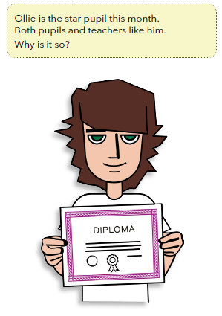
Look at the picture and answer the questions.
Who is he?
What is he like?
What is in his hands?
Why do you think other pupils and teachers like him?

Slide 4
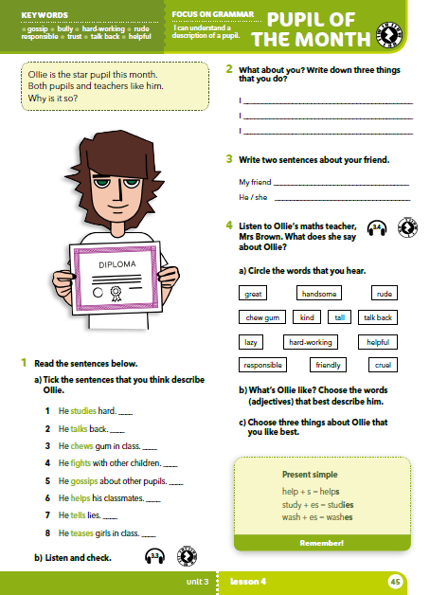
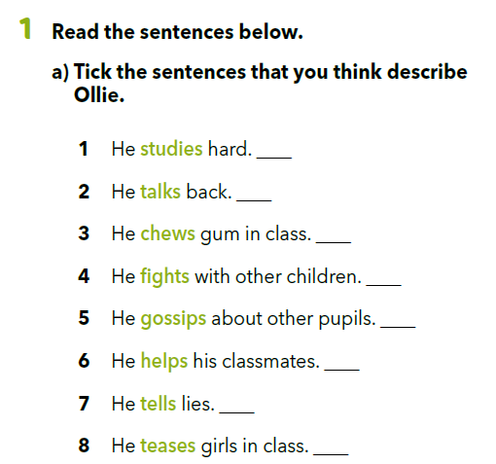

Read and tick the sentences that you think describe Ollie.

Listen and check.

https://www.e-sfera.hr/dodatni-digitalni-sadrzaji/8f66c734-eb93-4e57-b514-41153d7aba63/assets/audio/20_interview_part_1.mp3

Slide 5
Translate
study hard –
help classmates -
fight with other children –
chew gum in class –
gossip about other pupils –
talk back –
tell lies –
tease –
marljivo učiti
pomagati prijateljima iz razreda
svađati se s drugom djecom
žvakati žvakaću gumu na satu
ogovarati druge učenike
odgovarati (nepristojno)
lagati, govoriti laži
zadirkivati

Slide 6
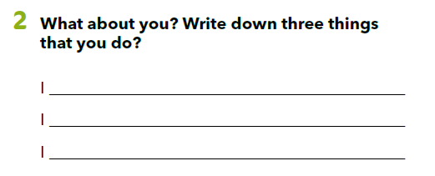
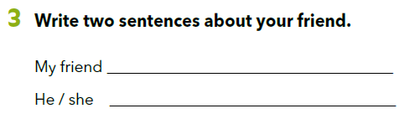

Slide 7
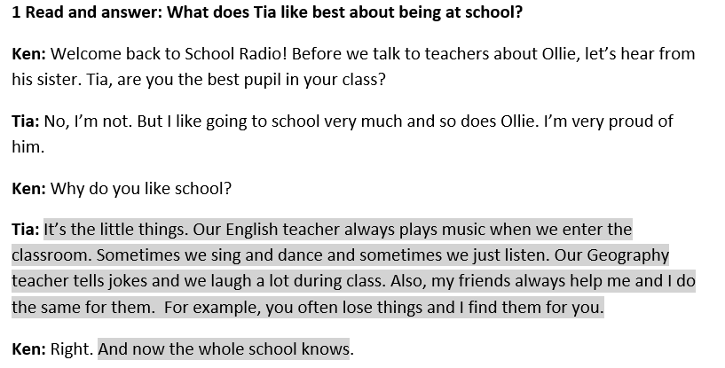

Slide 8
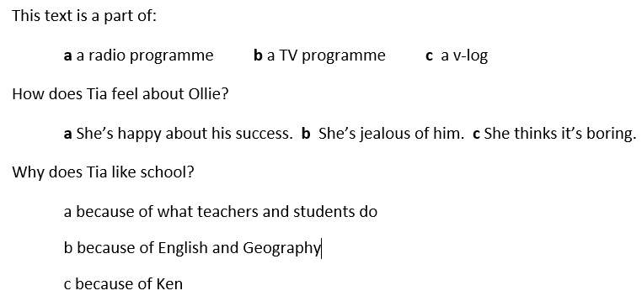
Read the text again and choose the correct answer.

Slide 9
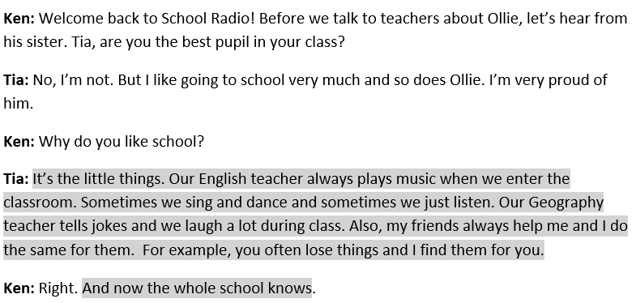
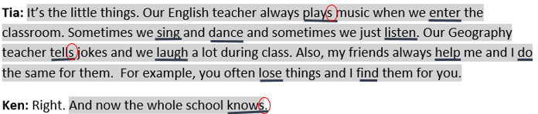
Look at the part of the text marked with grey. Underline the verbs in it.
Nekim glagolima je dodan nastavak „-s”.

Slide 10
Look at the examples.
Our English teacher plays music. → He/She plays music.
Our Geography teacher tells jokes. → He/She tells jokes.
The school knows. → It knows.
Zapamti!
Glagolu moramo dodati nastavak –s ili –es u 3. licu jednine (he, she ili it).

Slide 11
Let’s form sentences in the Present Simple.
play
I (play) tennis.
play
You (play) tennis.
play
We (play) tennis.
Present Simple koristimo kad govorimo o svojim navikama ili dnevnim rutinama, radnjama koje se stalno ponavljaju.
play
They (play) tennis.
plays
He (play) tennis.
plays
She (play) tennis.
plays
It (play) tennis.

Slide 12
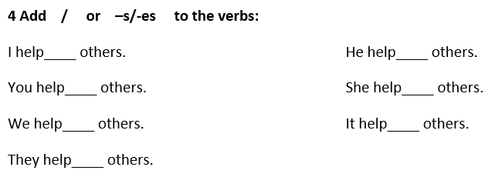
Copy the task in your notebook. Add / or –s / -es to the verbs.
/
s
/
s
/
s
/

Slide 13
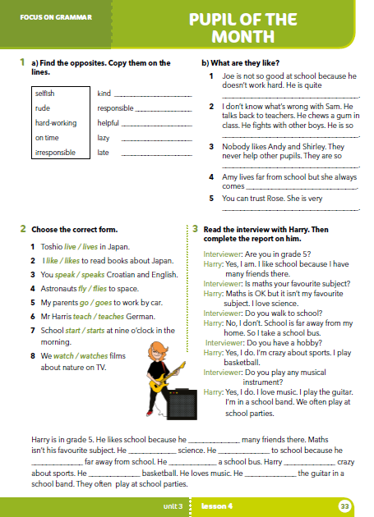
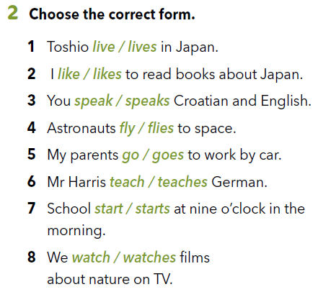
workbook p 33.

Slide 14
What does a pupil of the month do? Play this game.
https://wordwall.net/embed/9287c56473674f23ab92a5585ed3ec48?themeId=48&templateId=35%27%20frameborder=%270

Slide 15

https://www.e-sfera.hr/dodatni-digitalni-sadrzaji/8f66c734-eb93-4e57-b514-41153d7aba63/assets/audio/21_interview_part_2.mp3

Slide 16
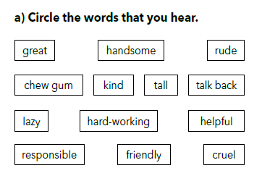
Listen and circle the words you hear.
https://www.e-sfera.hr/dodatni-digitalni-sadrzaji/8f66c734-eb93-4e57-b514-41153d7aba63/assets/audio/21_interview_part_2.mp3

Slide 17
Translate
great – hard-working –
handsome – helpful –
rude – responsible –
kind – friendly –
cruel –
super
marljiv
lijep, zgodan
koji rado pomaže
bezobrazan
odgovoran
ljubazan
prijateljski raspoložen, srdačan
okrutan

Slide 18
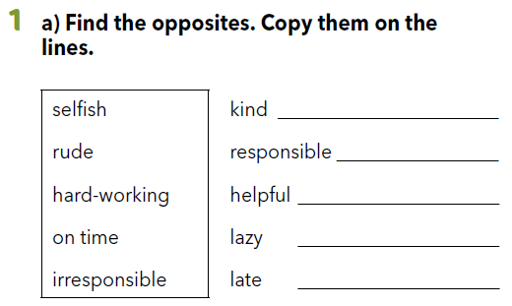
workbook p 33.
Translate
irresponsible –
selfish –
(be) late –
(be) on time -
neodgovoran
sebičan
koji kasni; kasniti
rude
(biti) točan, (biti) na vrijeme
irresponsible
selfish
hard-working
on time

Slide 19
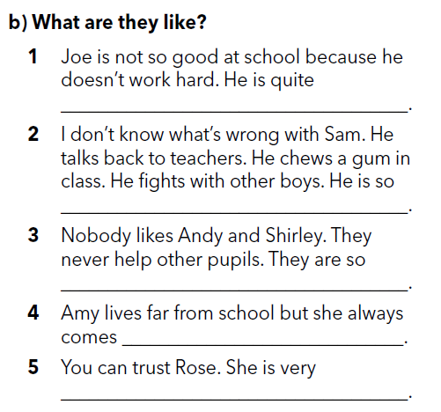
lazy
rude
selfish
on time
responsible

Slide 20


Ollie is great, hard-working, responsible, kind and helpful.
Would you like to have a friend like Ollie? Why?

Slide 21
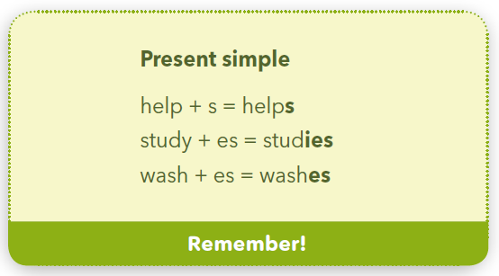
We add the suffix –s or –es to the verb in sentences with he, she, it.
Glagolu dodajemo nastavak –s ili –es u rečenicama s he, she, it.
Ollie helps other pupils. → He helps other pupils.
Anna studies hard. → She studies hard.
The school starts at 8 a.m.→ It starts at 8 a.m.

Slide 22
add suffix - es
in sentences with he, she, it when the verb ends in:
- o → go , do
- sh → wash , splash
- ch → watch , touch
- x → fix
- z → buzz
- ss -> kiss
es
es
es
es
es
es
es
es
es

Slide 23
When a verb ends in a consonant (r, l, b, c, d…) + y, it becomes –i and then you add –es.
Kad glagol završava na samoglasnik (r, l, b, c, d) i y, pretvara se u i i dodajemo nastavak –es.
dry → dries
fly → flies
worry → worries

Slide 24
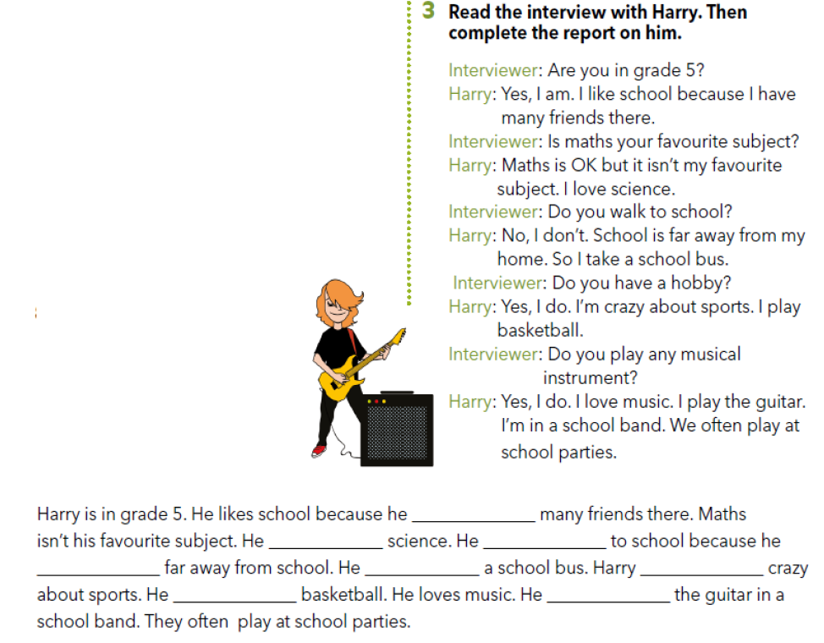
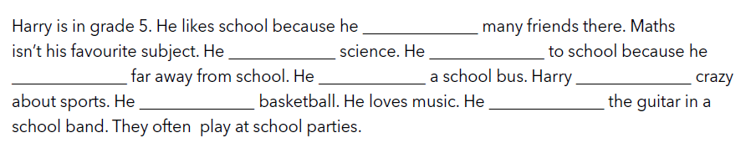
workbook p 33.
has
loves
doesn’t walk
lives
takes
is
plays
plays

Slide 25

SELF CHECK
https://www.e-sfera.hr/dodatni-digitalni-sadrzaji/8f66c734-eb93-4e57-b514-41153d7aba63/

